Slide 1
Actor Model
Roger Johansson
Proto.Actor and Akka.NET Founder Twitter: @rogeralsing
Github: rogeralsing
Mail: roger@asynkron.se

Slide 2

Actors
A programming paradigm

Slide 3
Actor Model
Three axioms:
Send – an actor can send messages to other actors
Spawn – an actor can spawn new actors
Become – an actor can decide how to handle it’s next message

Slide 4
Actor Model
”An island of consistency in a sea of concurrency”
”Shared nothing”, ”Black box”
”Location transparent”, ”Distributable by design”

Slide 5
Actor Model
BEAM – Erlang, Elixir, LFE
JVM – Akka, Orbit
.NET – Akka.NET, Proto.Actor, Project Orleans
Go – Proto.Actor

Slide 6
Proto.Actor
Next Generation Actor Model:
Built on standards – Protobuf, gRPC Streams, Consul/Kubernetes
Platform independent – C#, Go
Actors and Virtual Actors – Unified model of Akka and Project Orleans
Ultra fast – 65 times faster than Akka.NET over network

Slide 7
OOP vs. Actor Model
OOP
Actor Model
Behavior
Behavior
Stateful
Stateful
Synchronous method calls
Asynchronous message passing
Why Actors?? The synchronous model has worked nicely for 60 years!?

Slide 8
Moore’s Law
We can no longer build faster processors Instead, we stack them next to eachother and call them ”cores”

Slide 9
Why do we as developers have to care?

Slide 10
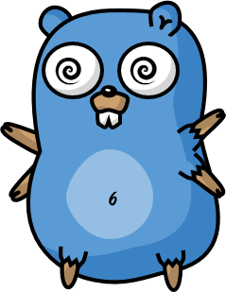
Scaling Up

Slide 11
Multi-Core programming in Go?
Goroutines
Channels
WaitGroups
…

Slide 12
What happens when you cannot
scale up any more?

Slide 13
Scaling Out

Slide 14
How do you scale out using Go?
Services, HTTP or gRPC
Queues and logs, Rabbit MQ or Kafka
…

Slide 15
We have different tools for scaling up and out.
An HTTP API has very little in common with a Goroutine.
You have to make decisions upfront on how to design your system

Slide 16
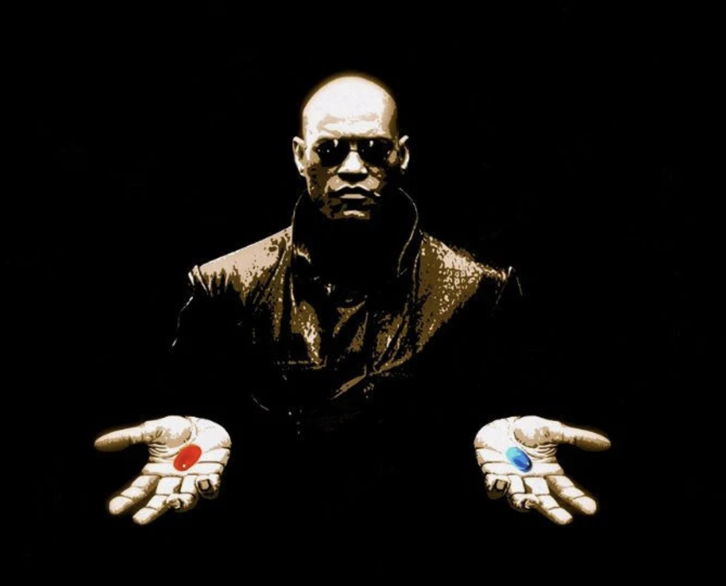
What if I told you…

Slide 17
Scale up and out, are essentially the same
That is; We want to execute code ”somewhere”, on a core, on a machine, in a cluster.
Why should we as developers have to resort to different technologies to do the same thing?

Slide 18
Event-driven thread
Actor
Mailbox
Transport
PID
Behavior
State
Supervision
Children

Slide 19
Hello World Demo

Slide 20
Chat Demo

Slide 21
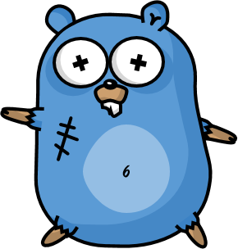
Design for failure
The famous Erlang 99.9999999% uptime

Slide 22
Let it crash
Protect state by delegating work
parent
Performs work, can be restarted
child

Slide 23
Website
Businesslogic
Data Access

Slide 24
Service Technician
Out of beans
Refill beans
Insert coins
Me
Vendor machine
Need more coins
Out of beans!
Gets coffee

Slide 25
Supervisor
Application error
Manage failures
Request
Client
Service
Validation error
Response

Slide 26
Error Kernel
/
99.9999999% uptime ~0.03 sekunder downtime per år
OneForOne supervisor
/a1
/a2
AllForOne supervisor
/b1
/b1
/b2
/b3
/b3
/c1
/c2
/c3
/c4
/c5

Slide 27
Bulkheads

Slide 28
Patterns and Practises

Slide 29
Behaviors
An actor can decide how to handle the next message

Slide 30
Behaviors
Imagine a game like World of Warcraft.
A character can be in different states.
e.g. Alive, Dead or even intoxicated.
While in these states, the character reacts differently to input.

Slide 31
Routers
A router is an ’actor-like’ object that can be used to route messages.
Routee1
4
3
2
1
Router
1
Routee2
Routee3
Forward to some target

Slide 32
Group Routers
Group router is used when you want to route to messages to a set of already existing actors.
Routee1
Router
Routee2
Routee3
You provide these

Slide 33
Pool Routers
Pool Routers are used when you just want to have a managed pool of workers.
Routee1
Router
Routee2
Routee3
The router provide these

Slide 34
Round Robin Routing
Round robin routing, as the name implies, allow you to pass messages in a round robin fashion to the target actors.
4
1
Routee1
Scale up!
4
3
2
1
Router
2
Routee2
.. Or down!
3
Routee3

Slide 35
Random Routing
For each message you send to the router, it will pick a random target to send the message to.
2
Routee1
4
3
2
1
Router
4
1
Routee2
3
Routee3
Random targets

Slide 36
Broadcast Routng
This router will send each message to all of the target actors.
Notifies all ”routees”
2
1
Routee1
2
1
Router
2
1
Routee2
2
1
Routee3

Slide 37
Consistent Hash Routing
This router will compute a hash from each message sent to it, and use this to select the target actor to send the message to.
A
M
Routee1
X
A
Y
M
Router
Y
Routee2
X
Routee3
Affinity between hash index and routee

Slide 38
Consistent Hash Routing
Maps hash of 123 to routee1
Id: 123
Id: 123
Stop
Create
Routee1
…
…
Id: 789
Id: 123
Id:456
Id: 123
Id:456
Router
Routee2
Payment
Stop
Create
Create
Create
…
…
…
…
…
Id: 789
Payment
Routee3
…

Slide 39
Middleware
There are two types of ”middleware” in Proto.Actor.
Receive Middleware and Send Middleware.
Actor
Receive
Send

Slide 40
Middleware
Open Tracing Middleware
Incoming, Message + Headers
Actor
Sender Middleware creates new headers when sending

Slide 41
Middleware
On this topic, see Greg Youngs presentation ”8 lines of code”
Message Handler
Receive
Send

Slide 42
Persistence
Proto.Actor Persistence, is based on the concepts from eventsourcing
Actor decides if message is persisted to DB
Actor
On start/restart, persisted messages are replayed to the actor

Slide 43
Patterns
Fan out – quickest reply
Send request to all targets
Fan out
?
Worker 1
Consumer
?
Router
?
Worker 2
?
Worker 3

Slide 44
Patterns
Use the first reply that comes back
Return first reply
!
Worker 1
Consumer
!
Router
!
Worker 2
!
Worker 3

Slide 45
Patterns
Use the first reply that comes back
Require same reply from at least N workers
!
Worker 1
Consumer
!
Router
!
Worker 2
!
Worker 3

Slide 46
Patterns
Throttling, the naive way
Add a delay after each message

Slide 47
Patterns
Throttling, a better way
Limit messages per time slice

Slide 48
Patterns
Bounded Mailbox
Mailbox
Actor

Slide 49
Patterns
Bounded Mailbox
Mailbox
Actor

Slide 50
Patterns
Work pulling pattern
Producer
Send work
Worker 1
Work to be done
Work Done
Send work
Worker 2
Work to be done
Work Done

Slide 51

Virtual Actors
Always Exists, Never Fails

Slide 52
Virtual Actors
Virtual actors are:
Virtually always existing
Addressed via ”Identity” and ”Kind”
Request Response driven
Built ontop of plain actors

Slide 53
Virtual Actor ID
ID Hash
ID Owners
Node 1
Node 2
Node 3
Node 4
Node …
Actor Placement
Node 1
Node 2
Node 3
Node 4
Node …

Slide 54
Virtual Actor ID
ID Hash
Distributed Hashtable
Key
ID Owners
Node 1
Node 2
Node 3
Node 4
Node …
Rendezvous
Algorithm
Value
Actor Placement
Node 1
Node 2
Node 3
Node 4
Node …

Slide 55
Virtual Actor ID
ID Hash
Actor Placement
Node 1
Node 2
Node 3
Node 4
Node …

Slide 56
Virtual Actors
SomeId124 + Kind
SomeId123 + Kind

Slide 57
Virtual Actors

Slide 58

Realtime Map
Asset Actor
User Viewport
MQTT
Realtime Map

Slide 59
Challenges and solutions,
Dealing with stream processing at scale

Slide 60
Challenge: Avoid excessive DB reads
Where is ”source of truth?”

Slide 61

Request
Request
Request
Read
Write
Read
Write
Read
Write
Stateless Service
Source of truth

Slide 62
Request
Request
Request
Write
Write
Write
Stateful Actor
Source of truth
Never interact with the DB from elsewhere

Slide 63

Request
Request
Request
Write
Write
Write
Stateful Actor
Source of truth

Slide 64
Request
Request
Request
Write
Write
Write
Stateful Actor

Slide 65
Request
Request
Request
Write
Stateful Actor

Slide 66
Request
Request
Request
Write
Stateful Actor

Slide 67
Challenge: Concurrency management

Slide 68
Process many messages for different entities in parallel

Slide 69
Process many messages for different entities in parallel
1
2
3

Slide 70
Process many messages for different entities in parallel
1
2
Process one message at a time per entity
3

Slide 71
Challenge: Avoid network hops

Slide 72
Kafka

Slide 73
Kafka

Slide 74
Solution: Local Affinity

Slide 75
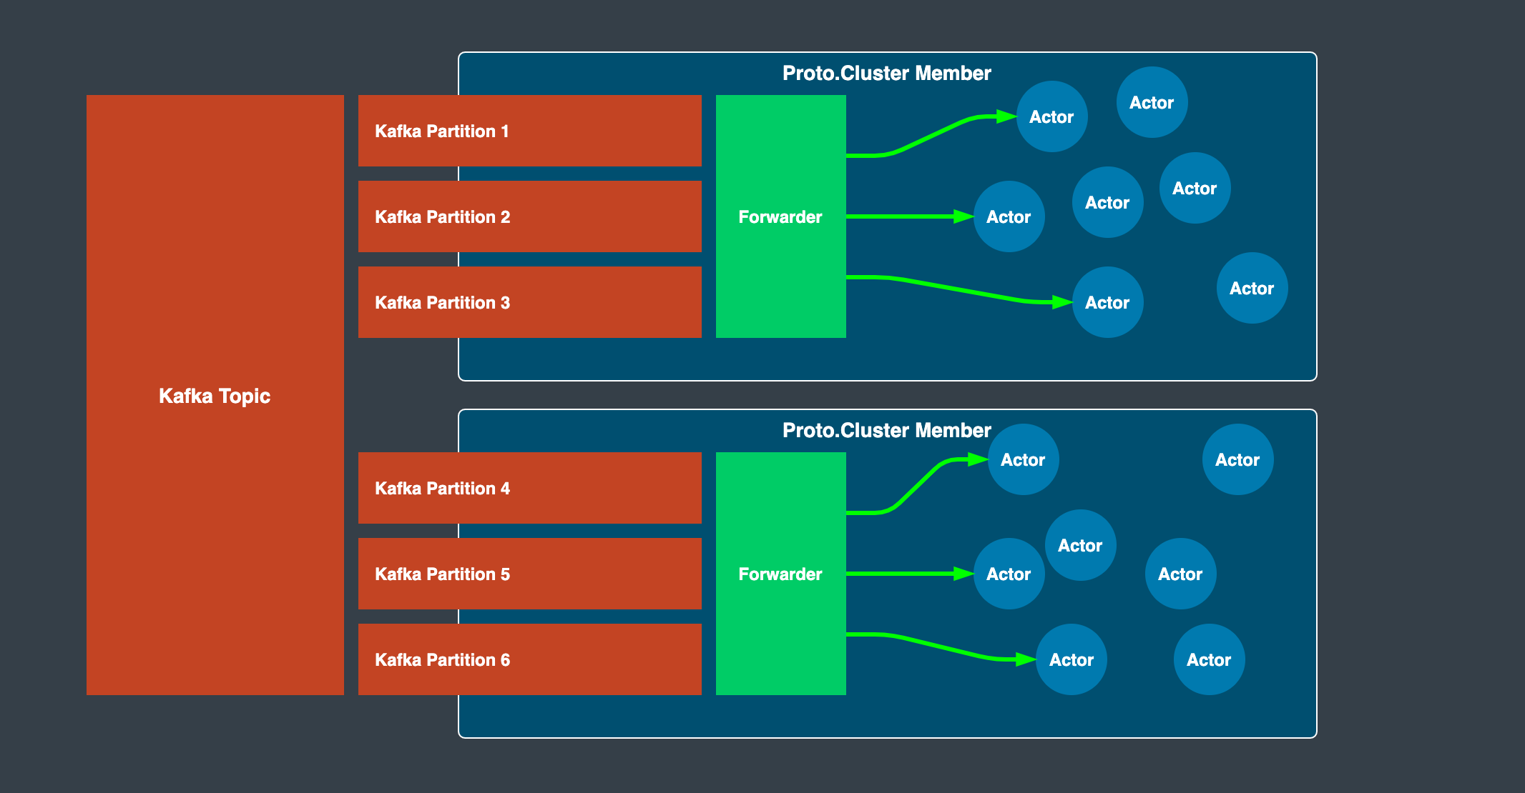

Slide 76
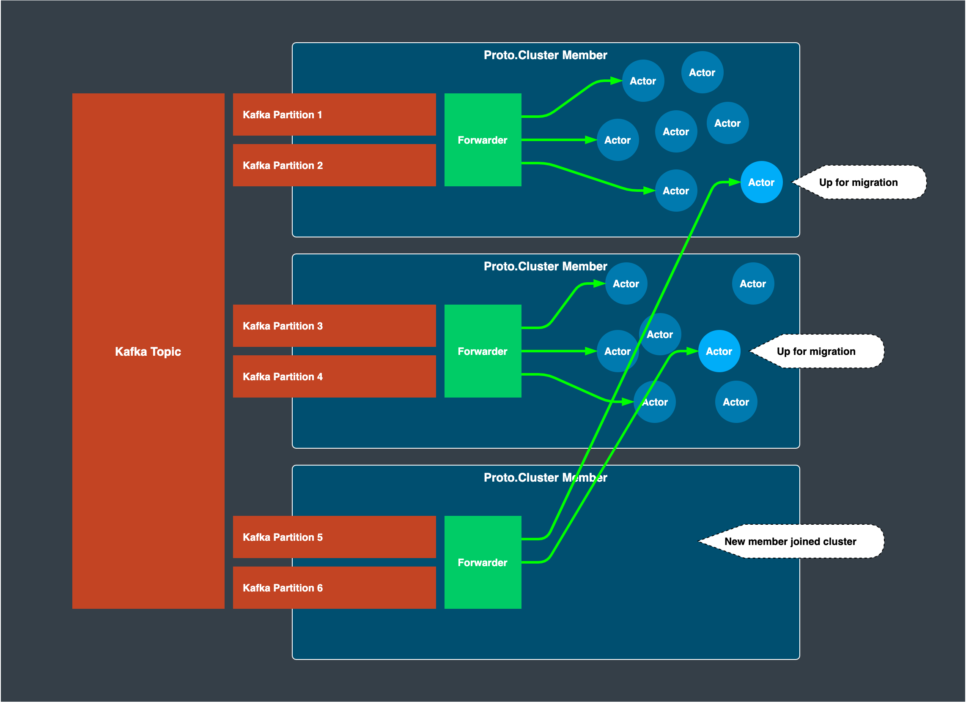

Slide 77
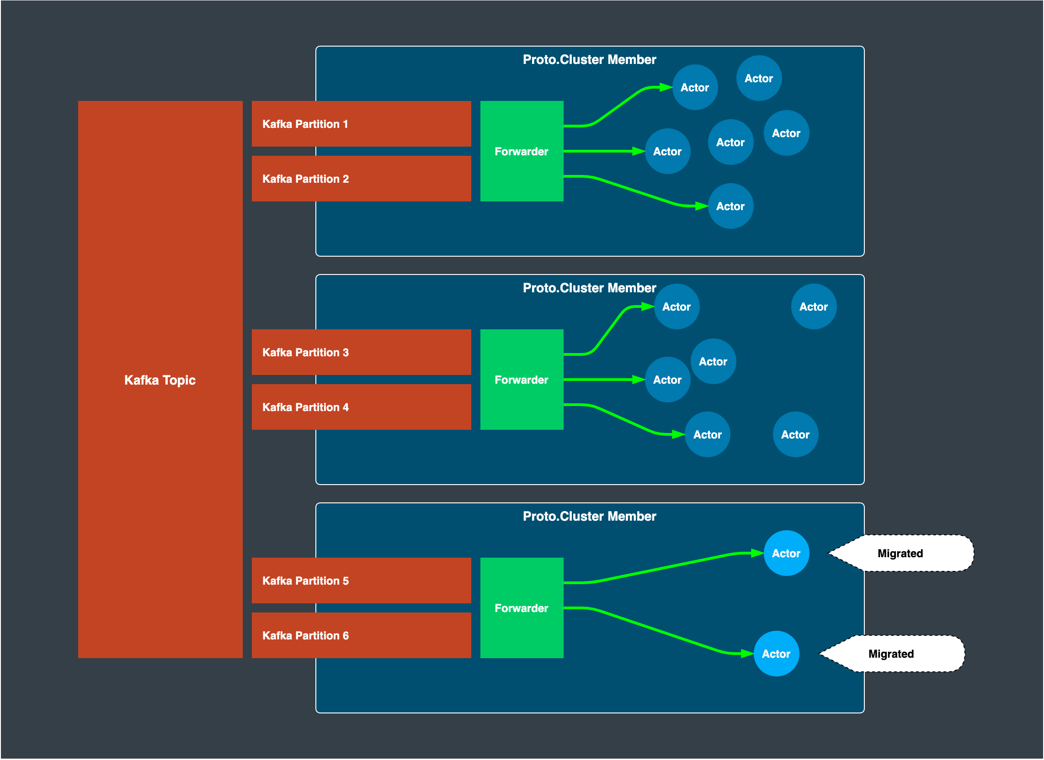

Slide 78
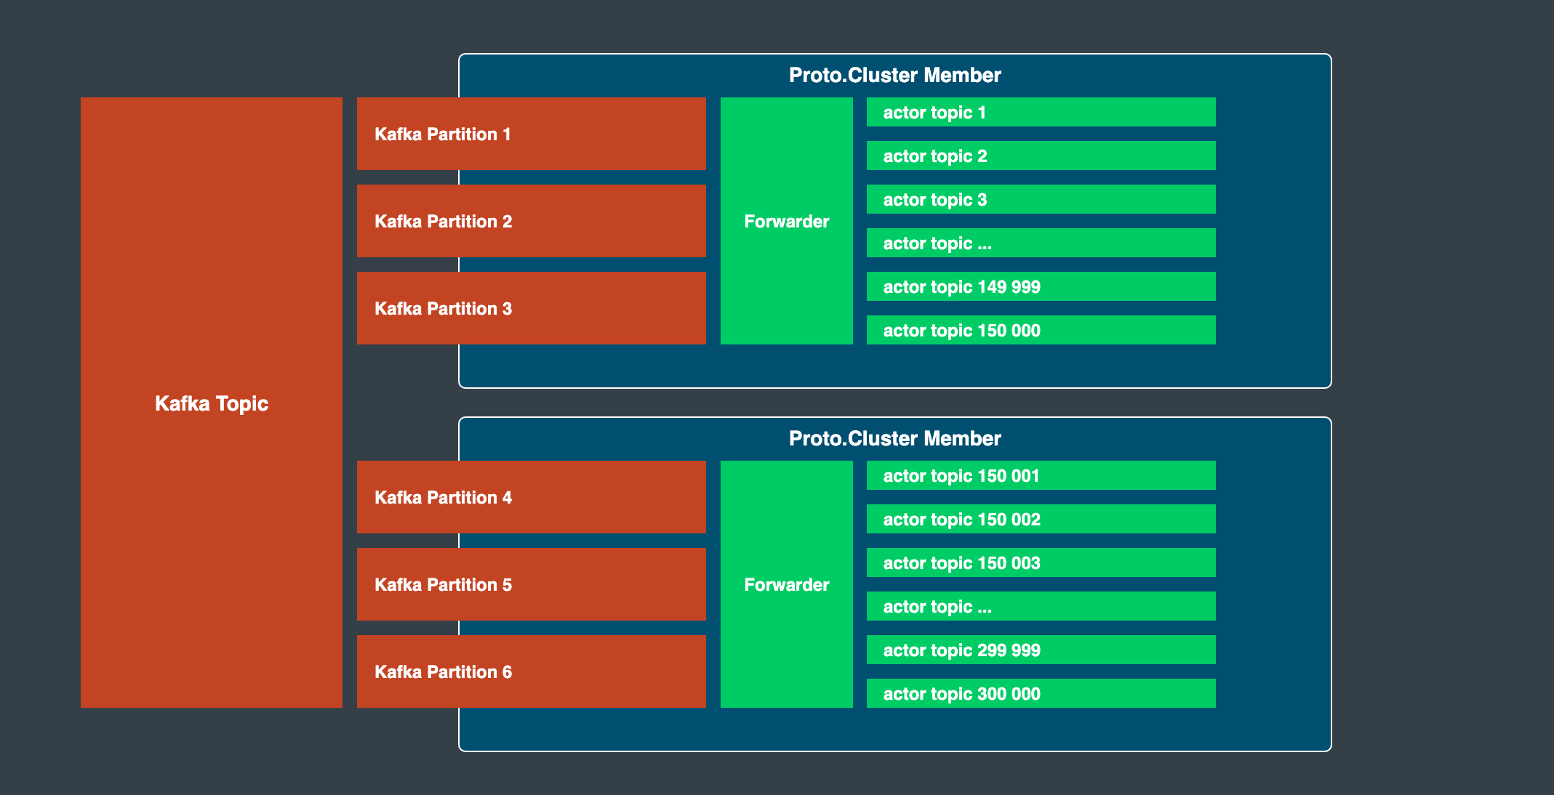

Slide 79
Solution: Envelope Pattern

Slide 80
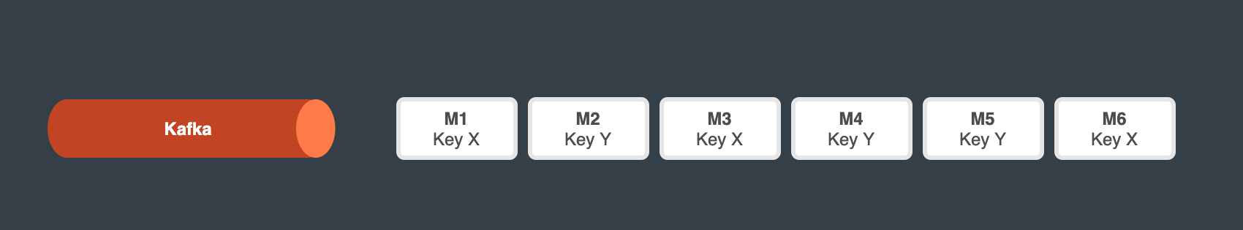

Slide 81
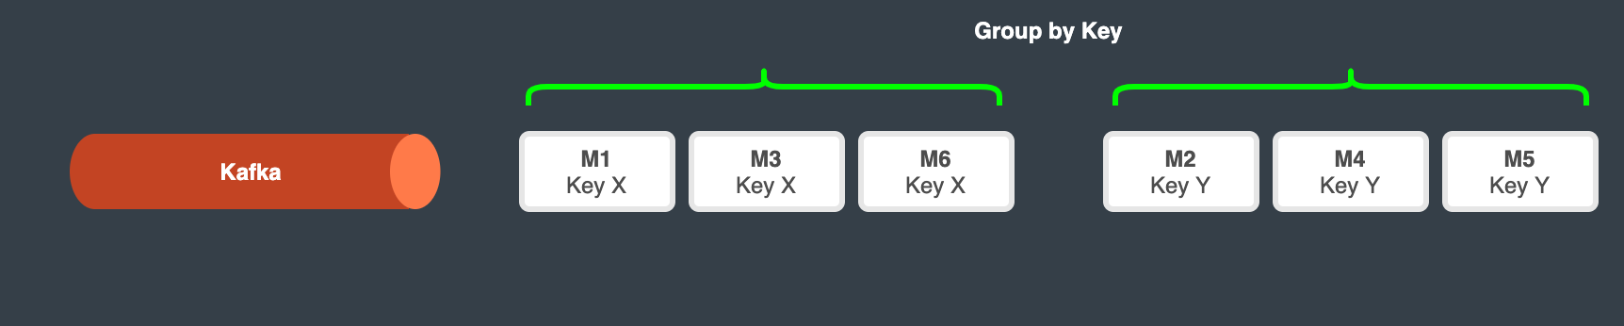

Slide 82
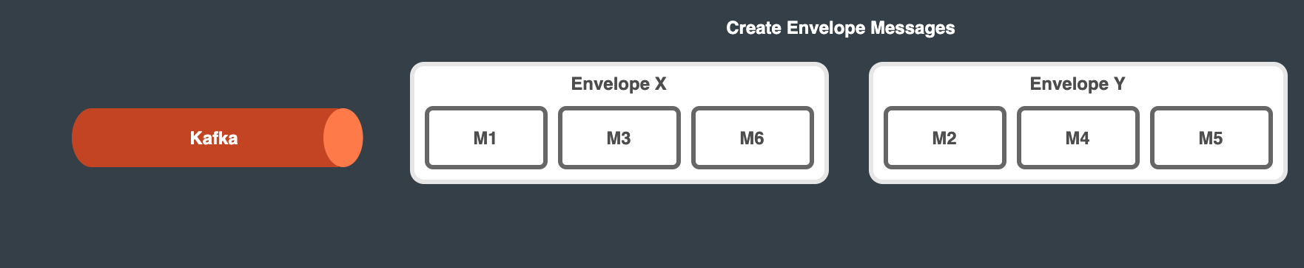

Slide 83
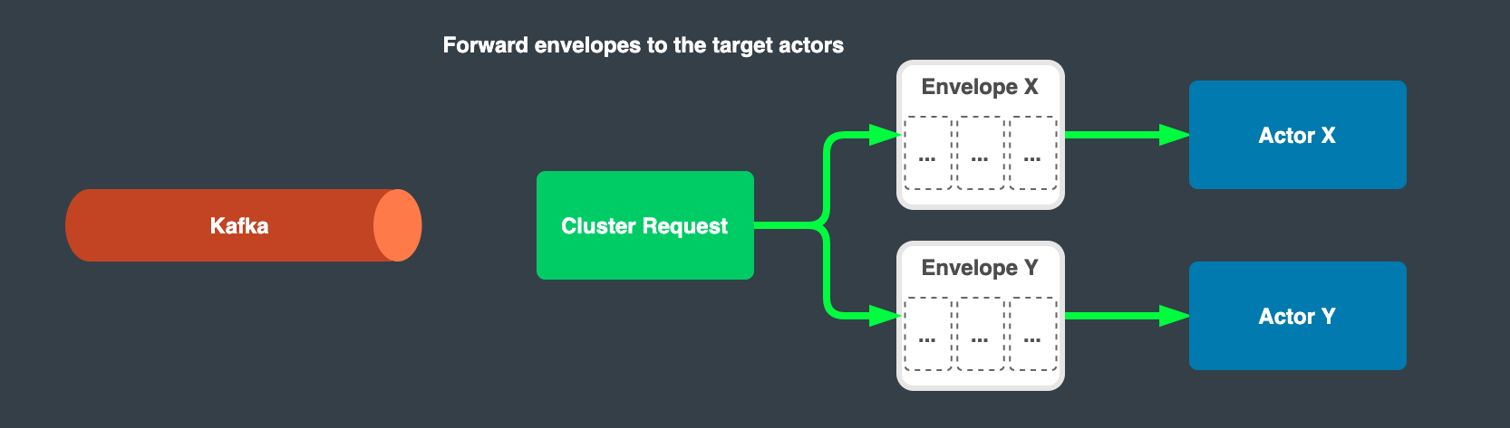

Slide 84
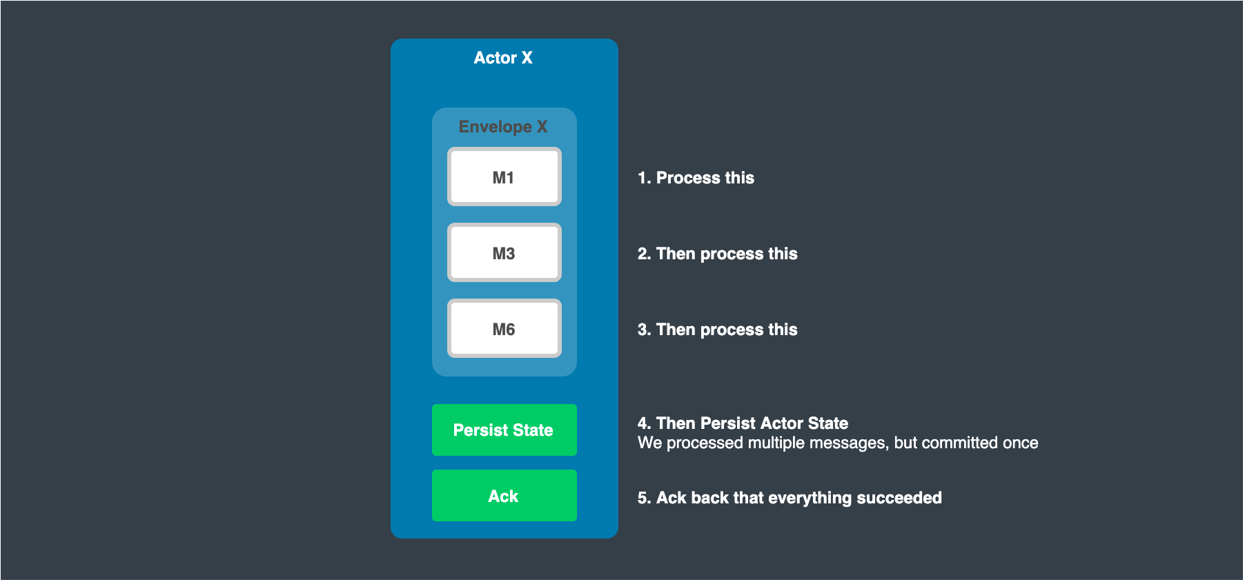

Slide 85
